Slide 1
Value Stock Metrics Investigation
Harry Lipscomb

Slide 2
Main Ratios Considered
Return on Capital = (net income – dividends) / (debt + equity)
A profitability ratio to determine how effectively a company can utilise equity and debt to produce profits.
Earnings Yield = EBIT (earnings before interest and taxes) / enterprise value
How much profit a company makes per $1 of share price.
Debt-Equity Ratio = debt / equity
The level of debt a company has compared to its size (>70% should be avoided).

Slide 3
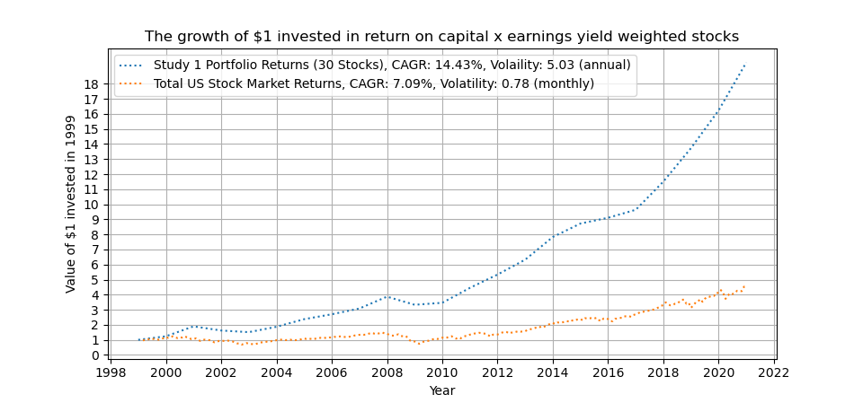
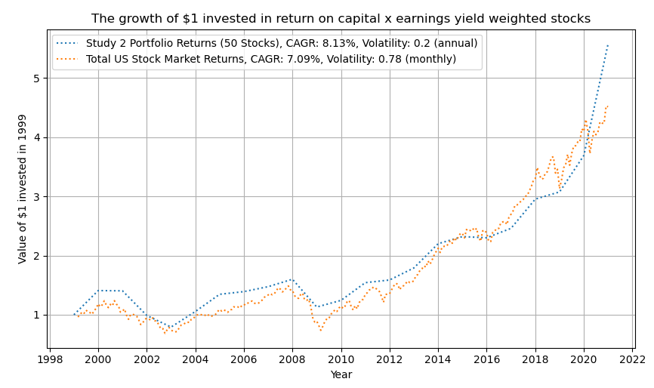
Large-Cap Survivorship Bias

Slide 4
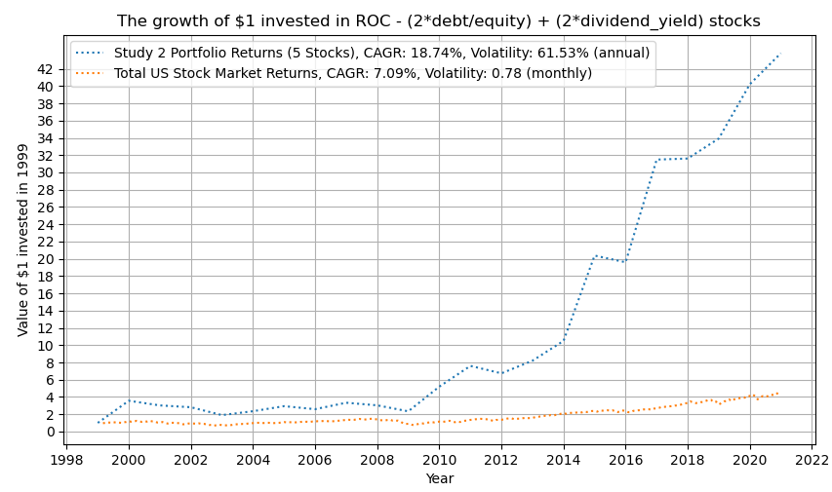
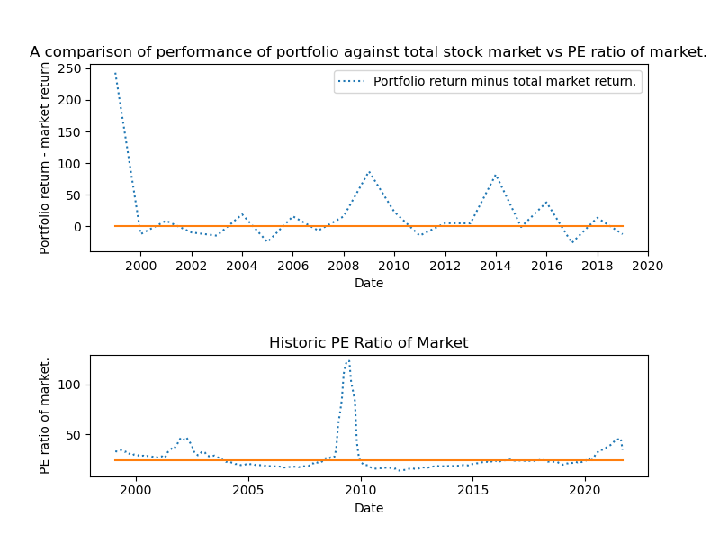
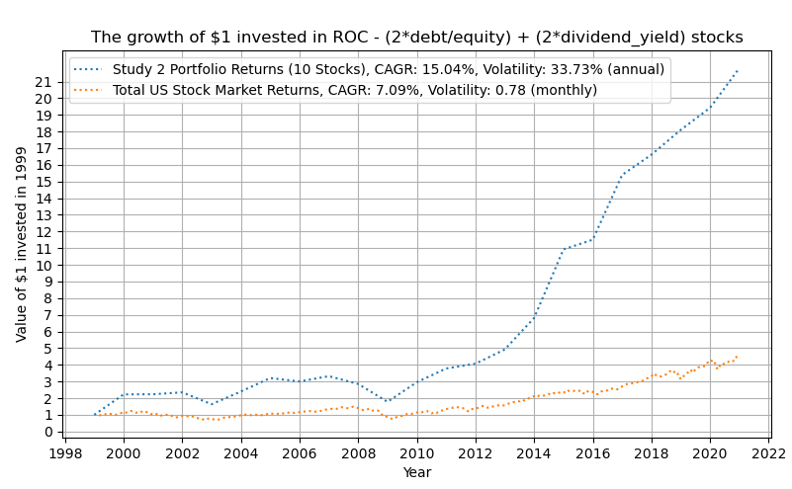
Optimum Metric Combination
Return on Capital – (2 x Debt-Equity) + (2 x Div. Yield)

Slide 5
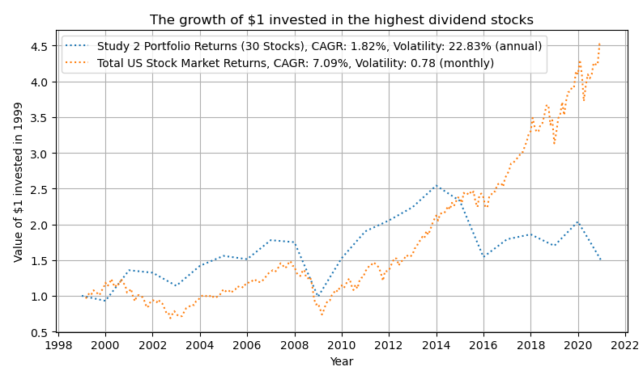
Dividend Heavy Portfolios
Average dividend yield of portfolio: 9.55%. Average dividend yield of stock market: 2.21%. Dividend heavy portfolios marginally outperforms the total market when dividends wholly re-invested.

Slide 6
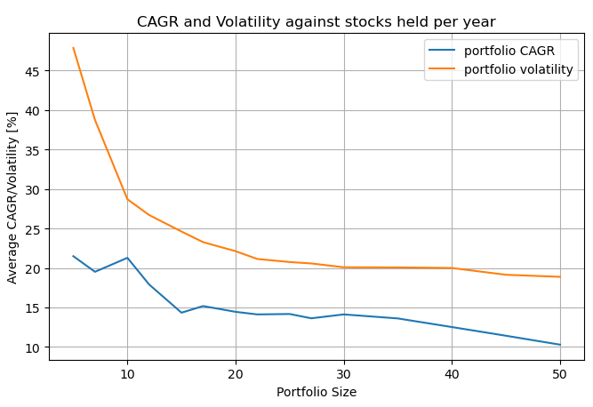
Portfolio size and volatility
Portfolio volatility was found to dramatically reduce once the number of stocks held reached approximately 30.
Here, volatility of portfolio within 10% that of the entire market.

